Slide 1
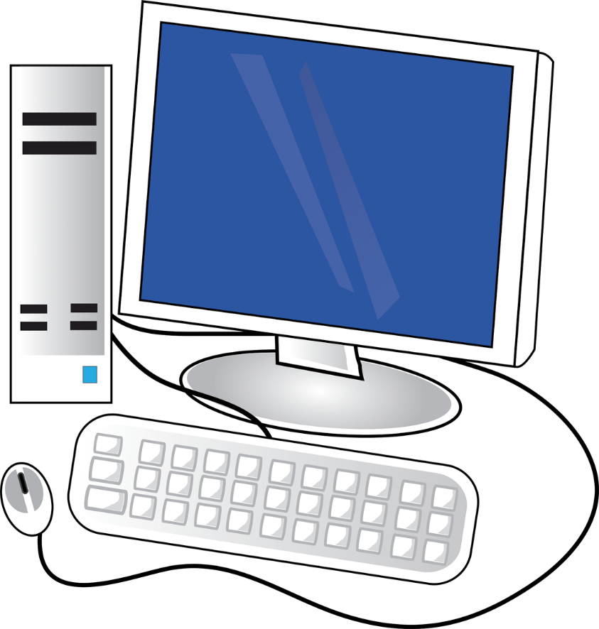
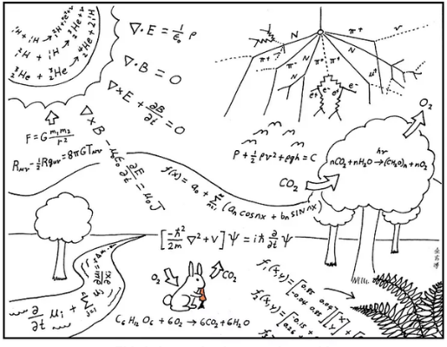
Programming for Physics

Slide 2
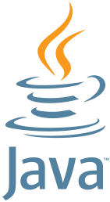
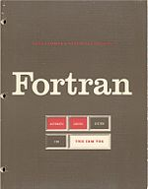
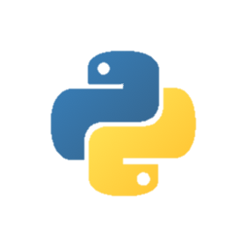
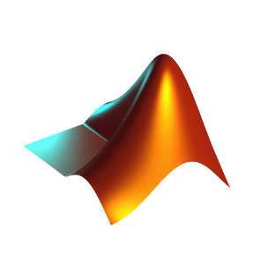
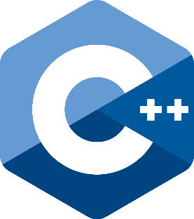
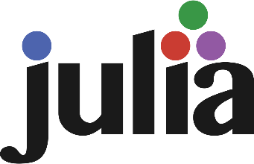

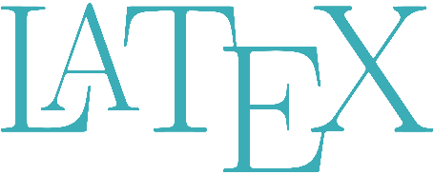
Commonly used software and programming languages
python
matlab
mathematica

Slide 3
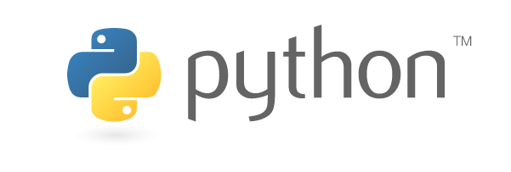
Why are we learning python in this course:
Python is free, open source
Overall larger community
Better for learning programming
Better for performing some tasks

Slide 4
What if my code takes too long to finish, or takes too much memory that my laptop can handle?
Texas A&M High Performance Research Computing
https://hprc.tamu.edu/

Slide 5
Python Overview
First release 1991 by Guido van Rossum
Python 2 (2000 – 2020)
Python 3 (2008 – now)
The goal
An easy and intuitive language just as powerful as major competitors
Open source, so anyone can contribute to its development
Code that is as understandable as plain English
Suitability for everyday tasks, allowing for short development times
“In December 1989, Van Rossum had been looking for a "'hobby' programming project that would keep [him] occupied during the week around Christmas" as his office was closed.” – Wikipedia

Slide 6
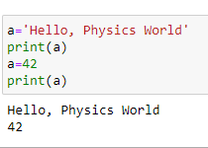
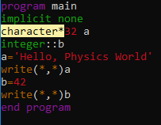
python
fortran
simple syntax
requiring compilation
interactive
static typing
dynamic typing
(the data type of a variable can change)

Slide 7
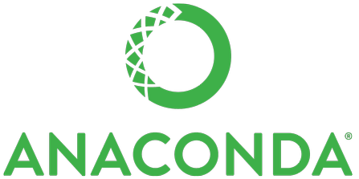
Open source, so anyone can contribute to its development
A huge collection of written code
A package management software
Anaconda is a free and open-source distribution of the Python and R programming languages for scientific computing (data science, machine learning applications, large-scale data processing, predictive analytics, etc.), that aims to simplify package management and deployment. –Wikipedia

Slide 8
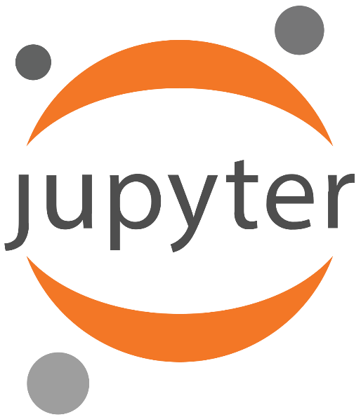
The Jupyter Notebook is an open-source web application that allows you to create and share documents that contain live code, equations, visualizations and narrative text. Uses include: data cleaning and transformation, numerical simulation, statistical modeling, data visualization, machine learning, and much more.

Slide 9

Basic Structure in Python
a line
many lines
a file
a folder
Anaconda
Variables
function & class
operations
statement
(a line of code)
module
package
(library)
flow control
Syntax
branch
loop
Variables
Programming in python is using variables, functions, modules, packages to complete certain tasks.

Slide 10
This and Next week
Variables
Operators
statement
Syntax

